Slide 1
NuE Reconstruction Efficiency Uncertainty from Intensity Dependence Study & Current Status
for the MINERvA Collaboration
Weekly Analysis Meeting
30 November 2018

Slide 2
NuE Analysis Uncertainties
Intro
Details
Checks
Intensity Dependence Reco. Uncrt. Study
Event Scan
Summary
Current Status
Source | Events | Fractional Uncertainty
Flux (simulated background) | 8.8 | 1.1
GENIE (not including CCQE) | 12.0 | 1.6
CCQE shape | 13.0 | 1.7
Beam angle | 0.5 | 0.1
Electromagnetic energy scale | 13.0 | 1.8
Reconstruction efficiency | 20.0 | 2.7
2p2h | 4.0 | 0.5
DFR-NC | 0.8 | 0.1
Rad correction | 0.0 | 0.0
Total systematic uncertainty | 31.2 | 4.2
Statistical uncertainty | 33.6 | 4.5
How can we investigate to constrain the reco. efficiency uncertainty?
Does the incoming beam divergence make sense?
Do we model our reconstruction efficiency correctly?
Looking at the failed reconstruction events can give a upper bound?
Biggest source of uncertainty
E. Valencia Doc-DB:19390 (cosmetic modification)

Slide 3
NuE Analysis Uncertainties
Intro
Details
Checks
Intensity Dependence Reco. Uncrt. Study
Event Scan
Summary
Current Status
Source | Events | Fractional Uncertainty
 |  | ME | LE
Flux (simulated background) | 8.8 | 1.1 | 0.2
GENIE (not including CCQE) | 12.0 | 1.6 | 2.3
CCQE shape | 13.0 | 1.7 | 3.1
Beam angle | 0.5 | 0.1 | 0.2
Electromagnetic energy scale | 13.0 | 1.8 | 1.8
Reconstruction efficiency | 20.0 | 2.7 | 2.7
2p2h | 4.0 | 0.5 | -
DFR-NC | 0.8 | 0.1 | -
Rad correction | 0.0 | 0.0 | -
Total systematic uncertainty | 31.2 | 4.2 | 5.1
Statistical uncertainty | 33.6 | 4.5 | 12.1
For LE NuE: reconstruction efficiency uncertainty for electrons was assumed same as it is for muons, since both particles tracks are seeded using the same technique
A lot has changed since LE publication, so we will adapt a different approach
ME: E. Valencia Doc-DB:19390 (cosmetic modification)
LE: Phys. Rev. D 93, 112007 (2016)

Slide 4
NuE Dataset
Intro
Details
Checks
Intensity Dependence Reco. Uncrt. Study
Event Scan
Summary
Current Status
Playlist | Data | MC | Signal Only MC
1A | 9.52E+19 | 2.06E+20 | 2.88E+22
1B | 1.87E+19 | 5.94E+19 | 5.80E+21
1C | 4.74E+19 | 1.09E+20 | 1.36E+22
1D | 1.45E+20 | 3.08E+20 | 4.30E+22
1E | 1.05E+20 | 2.58E+20 | 3.08E+22
1F | 1.72E+20 | 3.56E+20 | 5.04E+22
1G | 1.42E+20 | 3.00E+20 | 4.16E+22
1L | 1.36E+19 | 2.89E+19 | 3.80E+21
1M | 1.71E+20 | 4.32E+20 | 4.80E+22
1N | 1.13E+20 | 2.64E+20 | 2.00E+22
1O | 2.99E+19 | 7.84E+19 | 9.01E+21
1P | 4.75E+19 | 1.08E+20 | 1.32E+22
All | 1.10E+21 | 2.51E+21 | 3.08E+23
Processed sample Aug 2018
NOTE: the numbers are rounded

Slide 5
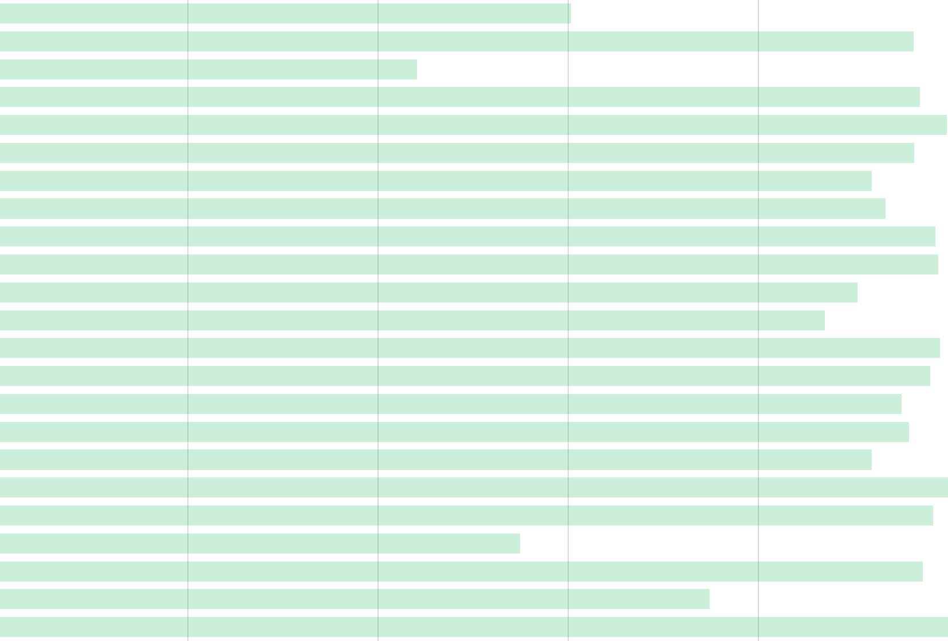
Applied Cuts and Package
Intro
Details
Checks
Intensity Dependence Reco. Uncrt. Study
Event Scan
Summary
Current Status
Applied a looser set of cuts (to get more statistics) and ran over all playlists
Applied Cuts
null reco
fiducial event
plausibility
minimum energy
bending angle
chi2 per DOF
ECAL-HCAL visible energy
max. transverse spread
peaks in ECAL
energy balance
asym. energy condition
shower end mod2
shower mean RMS at the 1st 3rd of the shower
dead time
vertex to shower
neighborhood energy
upstream interactions
non-trackable cluster in tracker
1-track and ignore nuclear tgt.
higher angle rejector
dEdx, photon rejecter
Q² - four momentum transfer squared
Eθ², main signal isolator
Analysis Packages
/Ana/AntiNuE/macros/sig_eff/
IntensityDependentStudy.C
intensity_result_summary.C
4. minimum energy>400 MeV (800*)
21. dEdx<11.5 (4.5*)
22. Q2<0.075 (0.025*)
23. Eθ²<0.0132 (0.0032*)
All other cuts are applied +
* default cuts

Slide 6
Batch Structure
Intro
Details
Checks
Intensity Dependence Reco. Uncrt. Study
Event Scan
Summary
Current Status
As the intensity increased in the ME run, it did not increase evenly across the entire gate. Due to slip-stacking there are twice the POT in certain of batches. This causes a decrease in the reconstructed events/POT in those batches.
Need to make sure we model this effect in MC and compare with data.

Slide 7
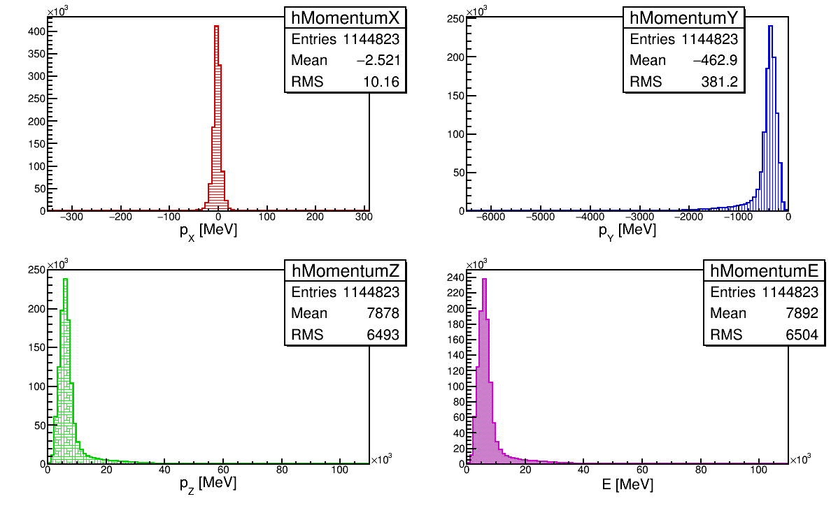
Does 𝞶-beam Divergence Make Sense?
Intro
Details
Checks
Intensity Dependence Reco. Uncrt. Study
Event Scan
Summary
Current Status
Looked at NuE Truth tree
Analysis Packages
/Ana/AntiNuE/macros/signal/
incomingParticleMomentum.C
Calculated angle w.r.t. Z axis = 58.76 mrad
Notes:
Looking at angles of the incoming neutrino

Slide 8
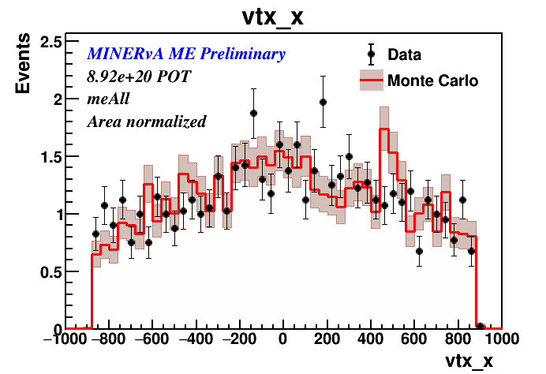
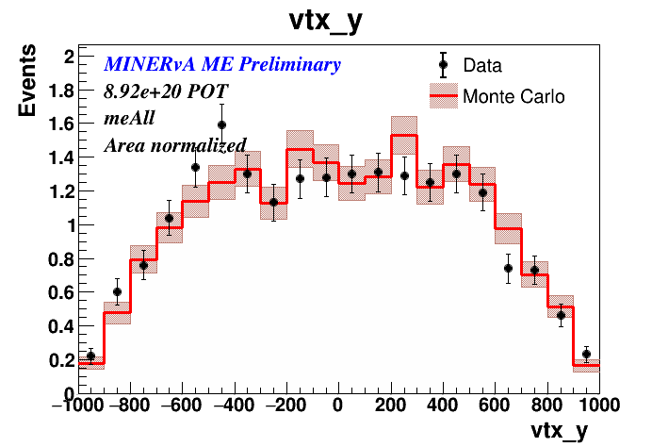
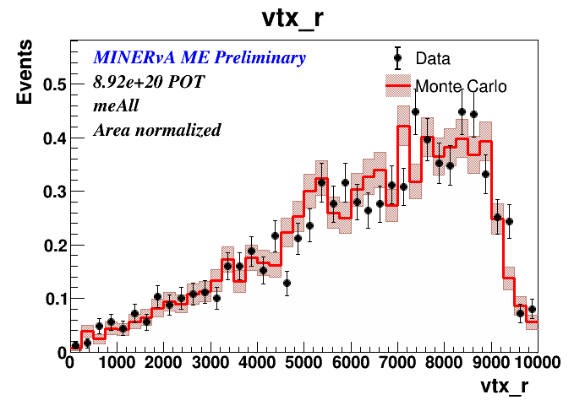
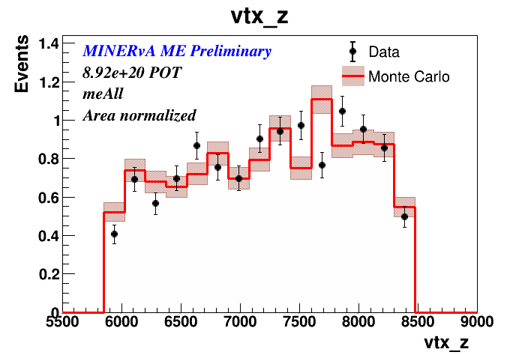
Is MC Correctly Simulating Efficiency?
Intro
Details
Checks
Intensity Dependence Reco. Uncrt. Study
Event Scan
Summary
Current Status
Vertices seems to be modeled well
More details:
DoC-DB 19945

Slide 9
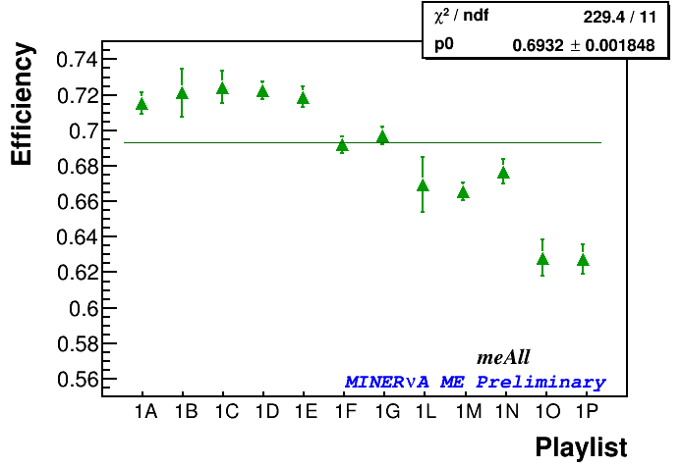
Intensity Dependence from Signal Only MC
Intro
Details
Checks
Intensity Dependence Reco. Uncrt. Study
Event Scan
Summary
Current Status
NuE Signal Only MC
Playlist | POT Used
me1A | 2.88E+22
me1B | 5.80E+21
me1C | 1.36E+22
me1D | 4.30E+22
me1E | 3.08E+22
me1F | 5.04E+22
me1G | 4.16E+22
me1L | 3.80E+21
me1M | 4.80E+22
me1N | 2.00E+22
me1O | 9.01E+21
me1P | 1.32E+22
meAll | 3.08E+23
The average efficiency drops with increased intensity

Slide 10
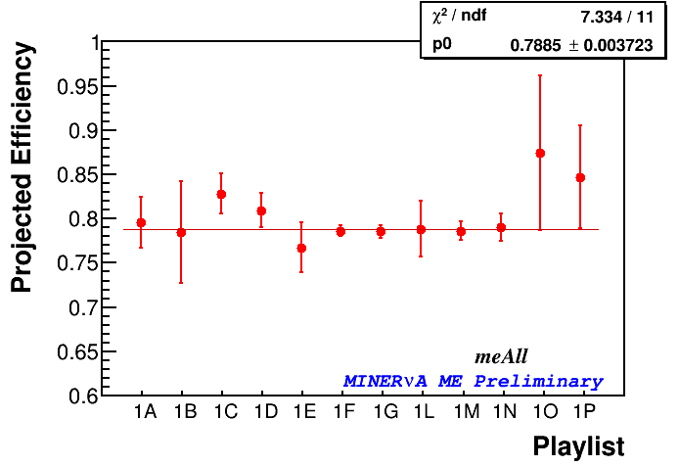
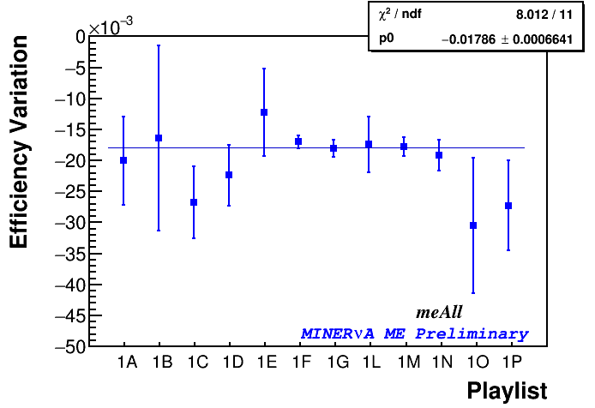
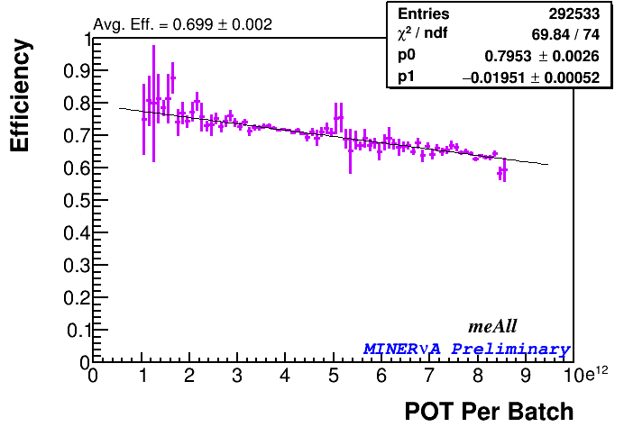
Intensity Dependence from Signal Only MC
Intro
Details
Checks
Intensity Dependence Reco. Uncrt. Study
Event Scan
Summary
Current Status
Batch by batch projected efficiency are stable within few percent
Batch by batch efficiency varies within ~3% in a batch
Playlist efficiencies matches within few percent, but have less statistics to see more detailed picture

Slide 11
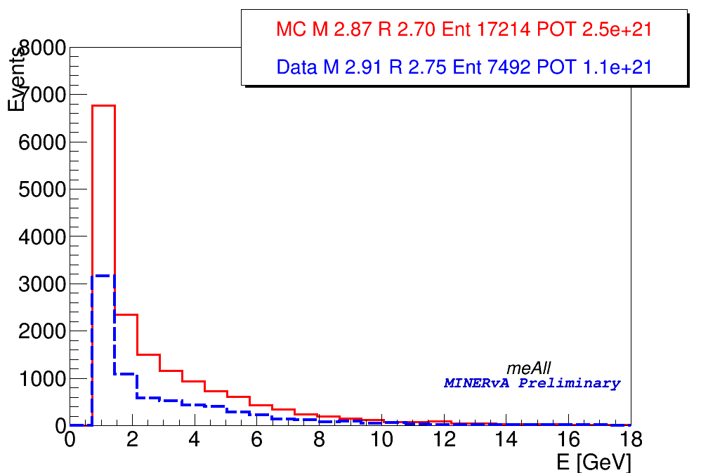
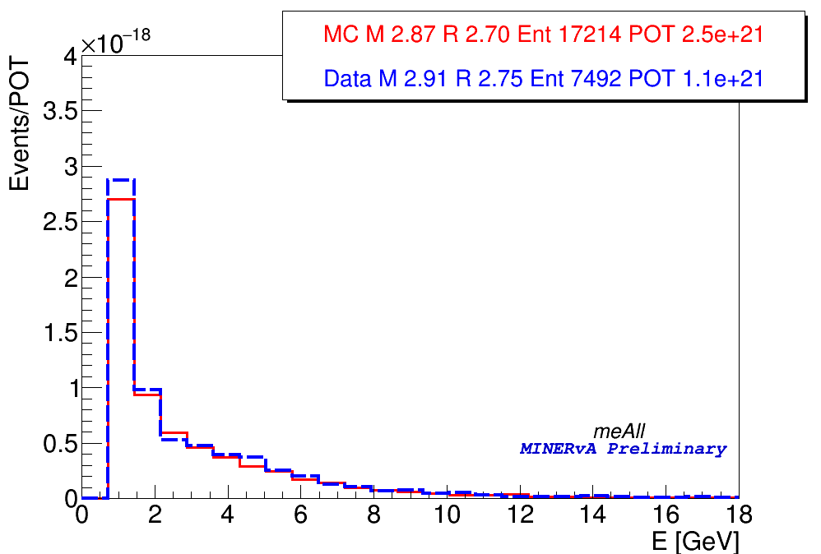
Energy Variable
Intro
Details
Checks
Intensity Dependence Reco. Uncrt. Study
Event Scan
Summary
Current Status
After normalizing
NuE MC and Data with looser cuts
MC and Data histograms are scaled by total POT

Slide 12
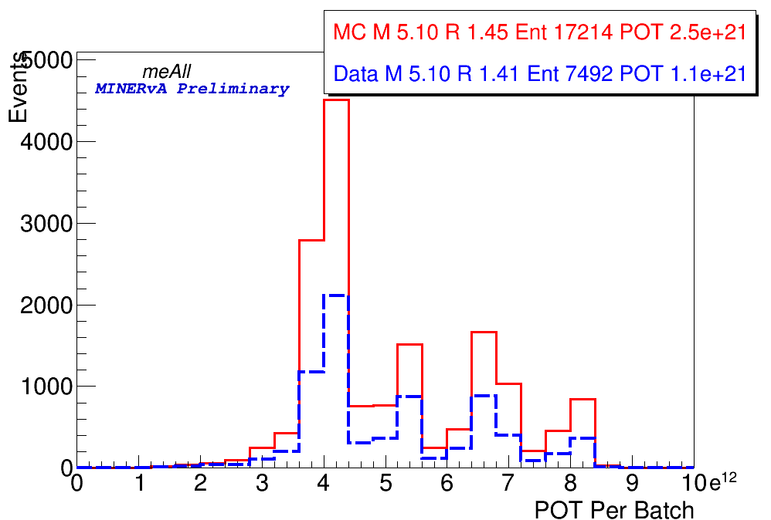
Intensity Dependence
Intro
Details
Checks
Intensity Dependence Reco. Uncrt. Study
Event Scan
Summary
Current Status
The intensity dependence of MC and data events.

Slide 13
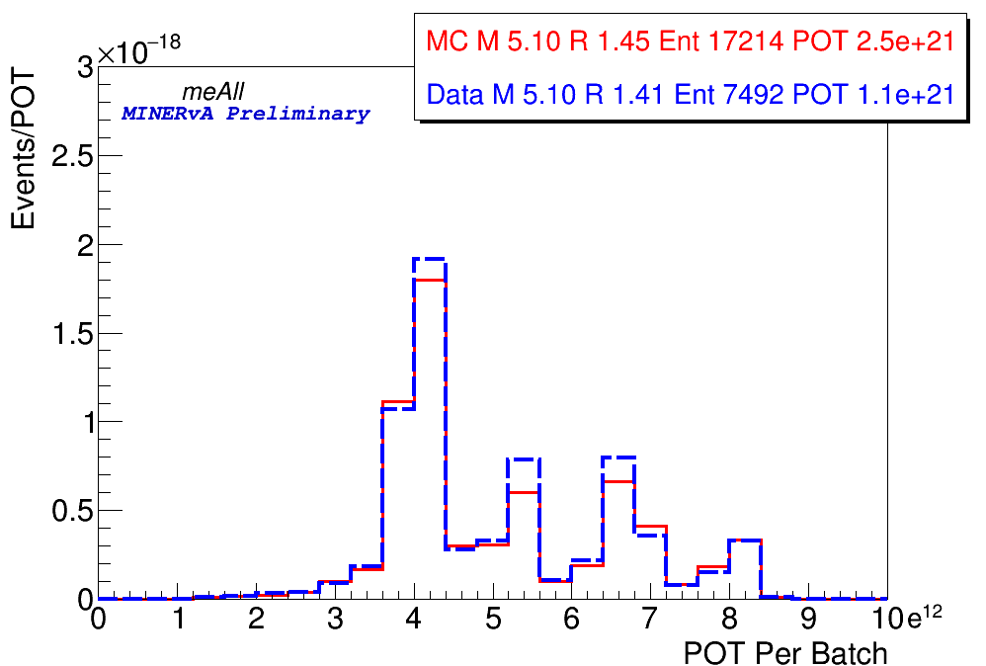
Intensity Dependence
Intro
Details
Checks
Intensity Dependence Reco. Uncrt. Study
Event Scan
Summary
Current Status
The intensity dependence of MC and data events.

Slide 14
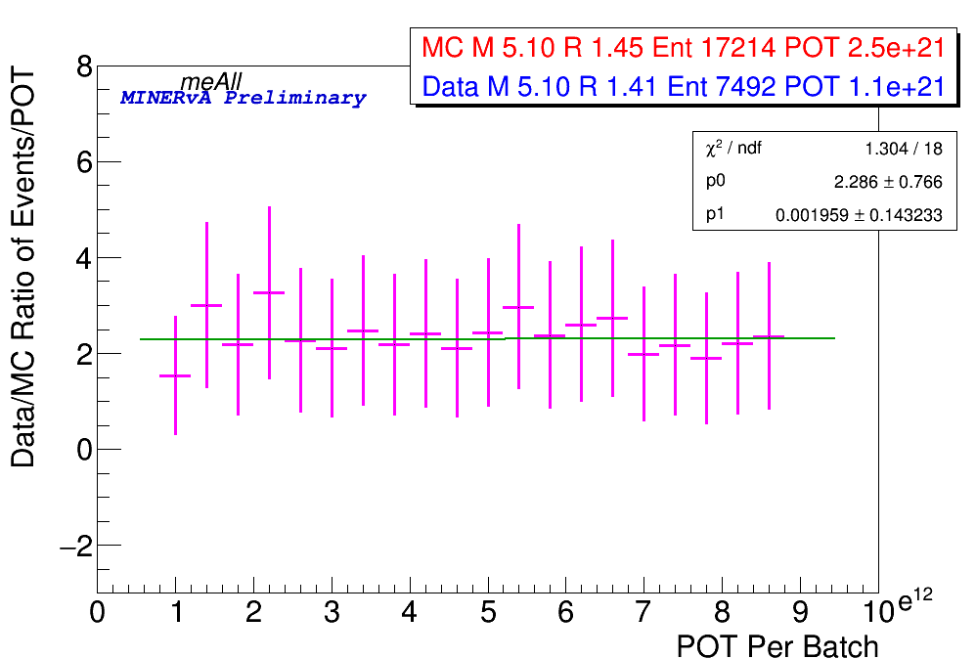
Data MC Ratio
Intro
Details
Checks
Intensity Dependence Reco. Uncrt. Study
Event Scan
Summary
Current Status
Data is consistent with MC for Events/POT vs Batch POT. Don’t see any intensity effect.

Slide 15
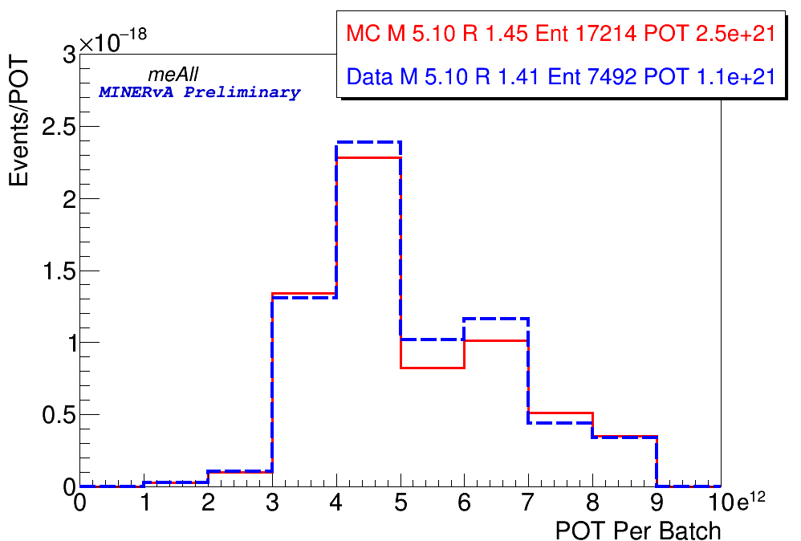
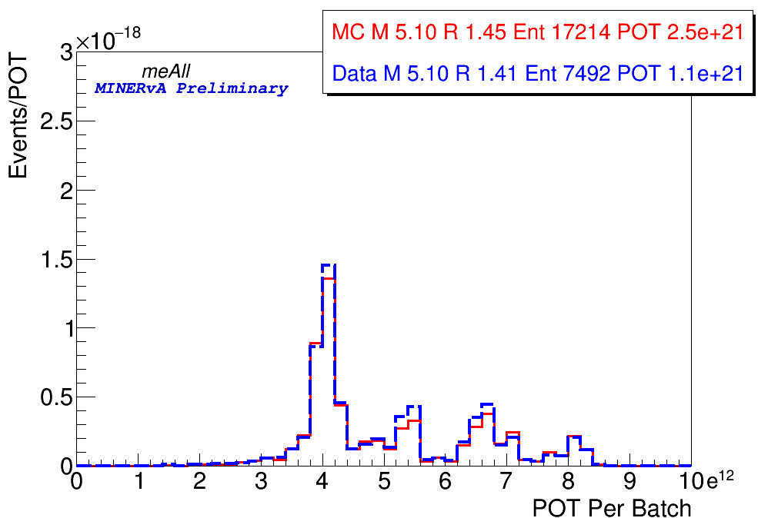
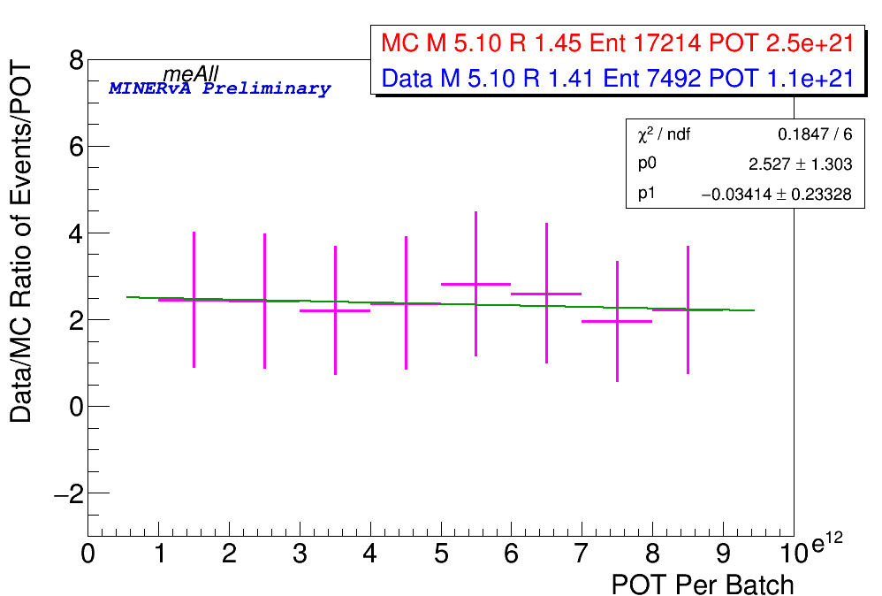
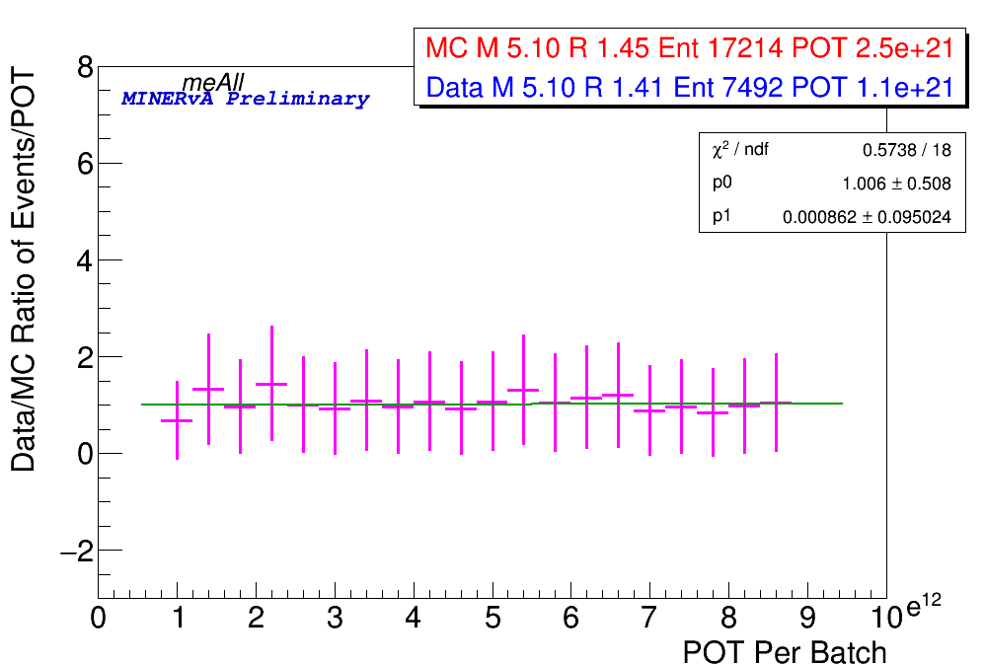
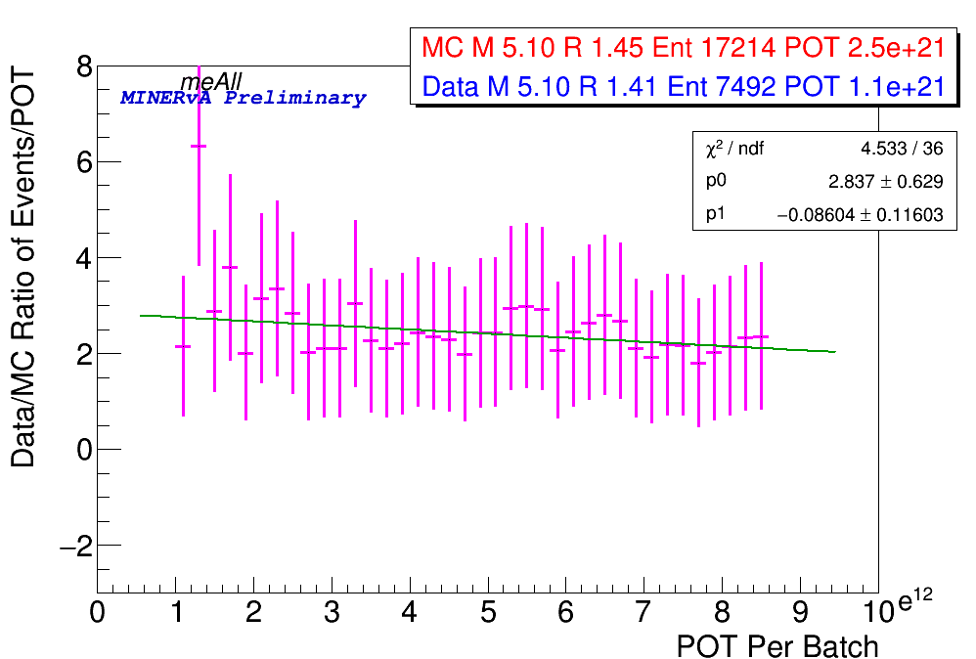
Different Binning
Intro
Details
Checks
Intensity Dependence Reco. Uncrt. Study
Event Scan
Summary
Current Status
Default
10 Bins
25 Bins
50 Bins
Default
10 Bins
25 Bins
50 Bins

Slide 16
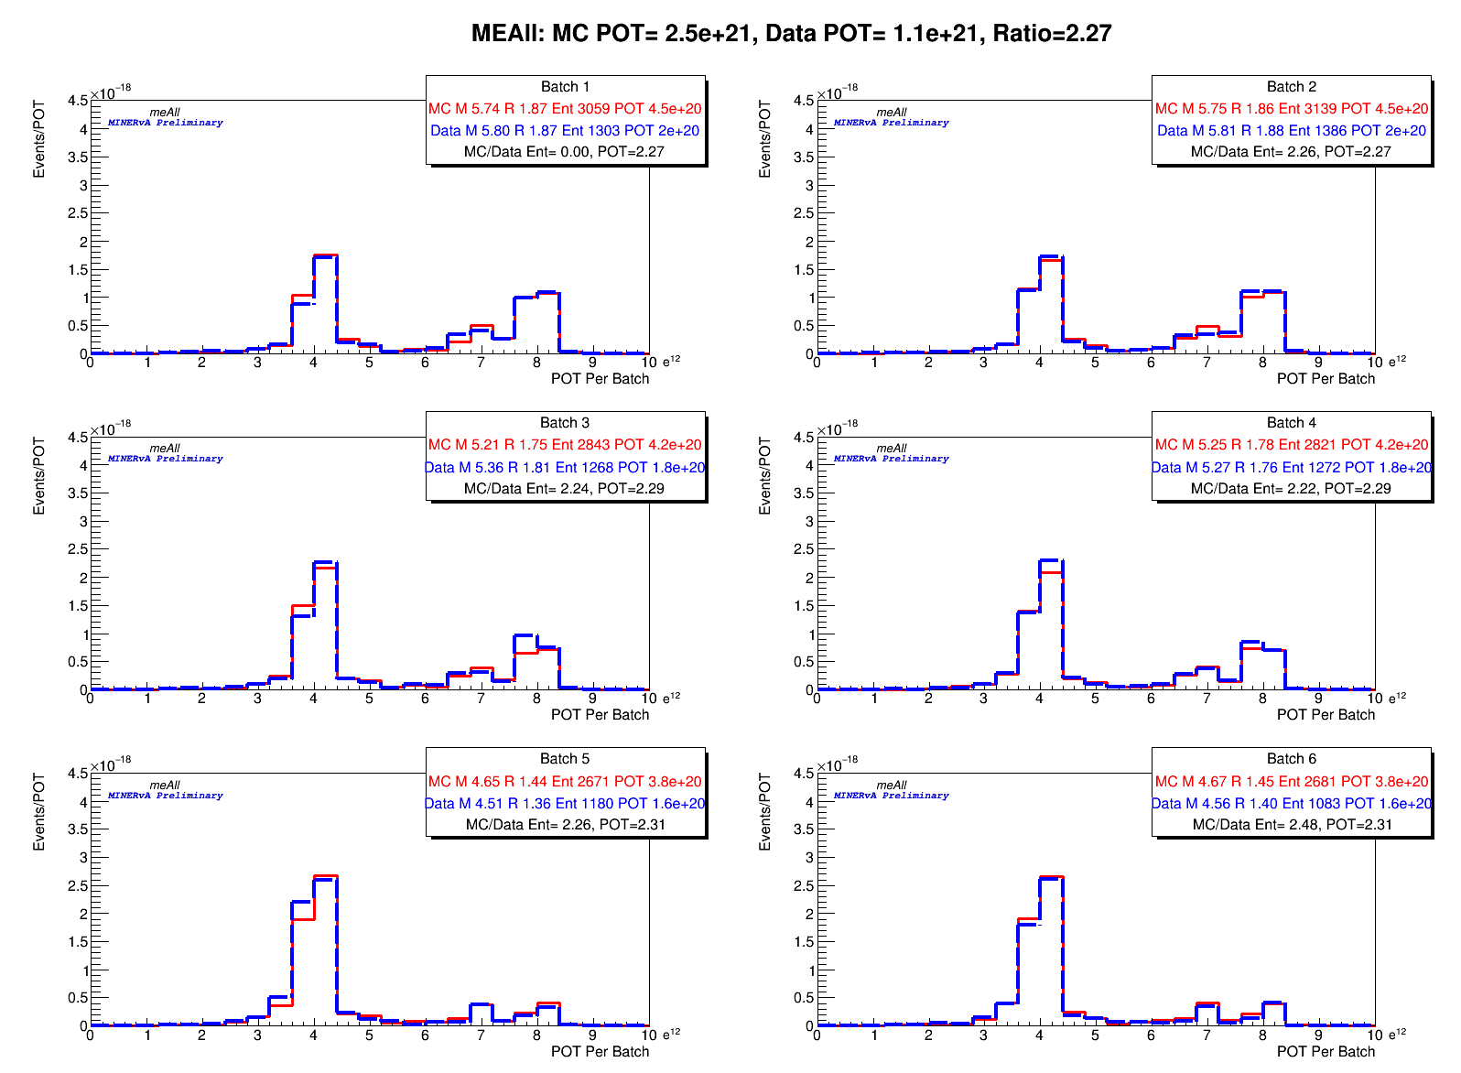
Comparison By Batch
Intro
Details
Checks
Intensity Dependence Reco. Uncrt. Study
Event Scan
Summary
Current Status

Slide 17
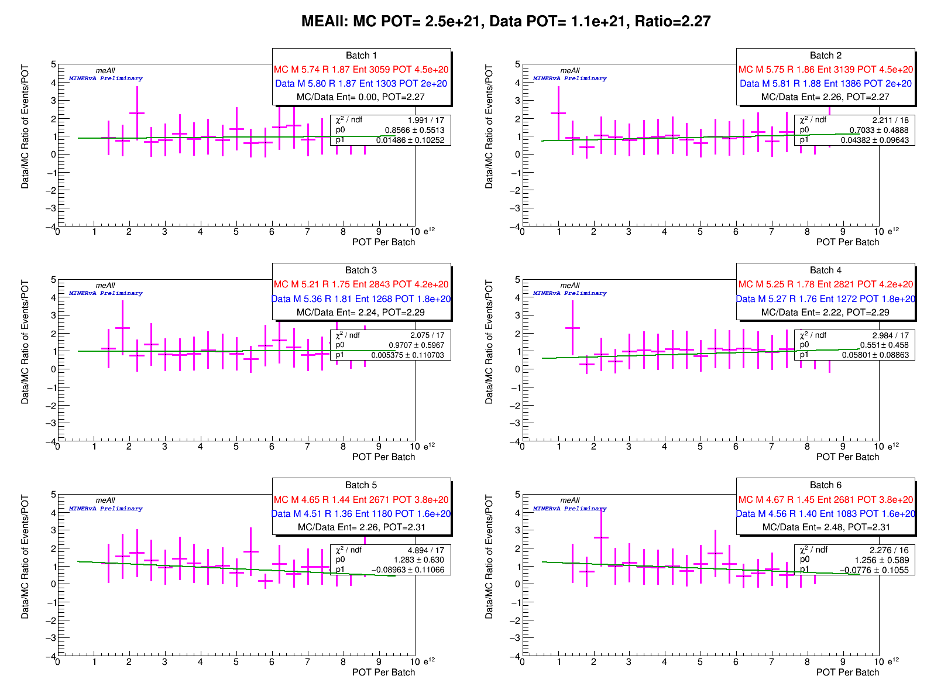
Comparison By Batch
Intro
Details
Checks
Intensity Dependence Reco. Uncrt. Study
Event Scan
Summary
Current Status

Slide 18
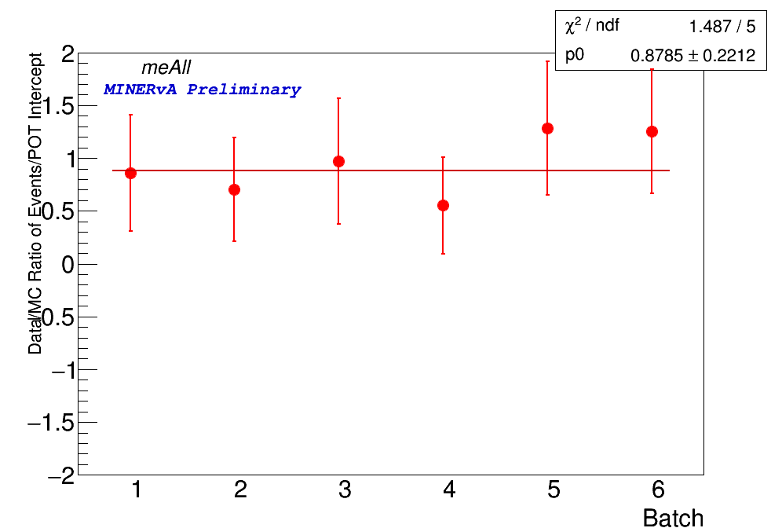
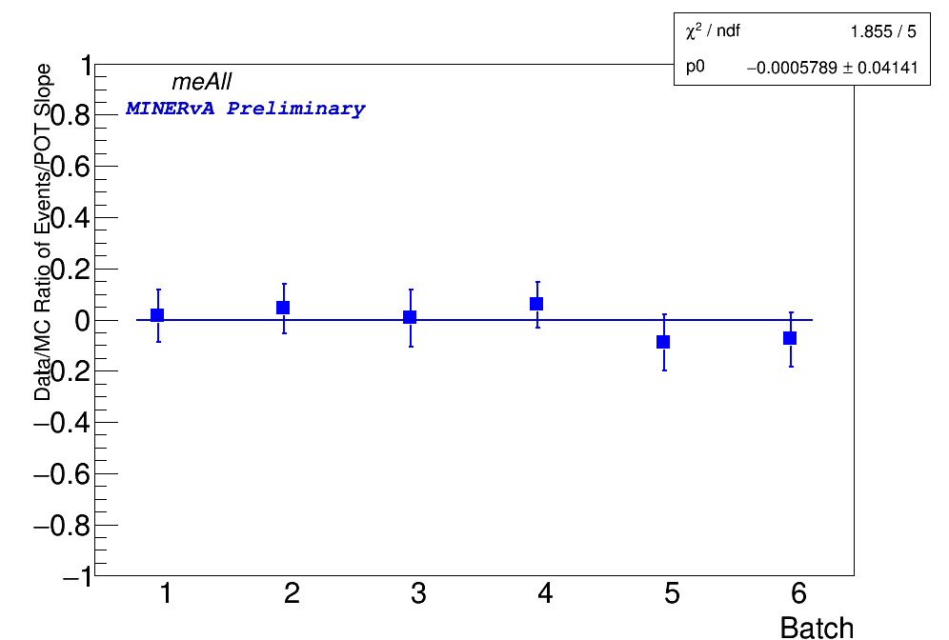
Comparison By Batch
Intro
Details
Checks
Intensity Dependence Reco. Uncrt. Study
Event Scan
Summary
Current Status
Data events are matching well with MC simulation for batch level comparison

Slide 19
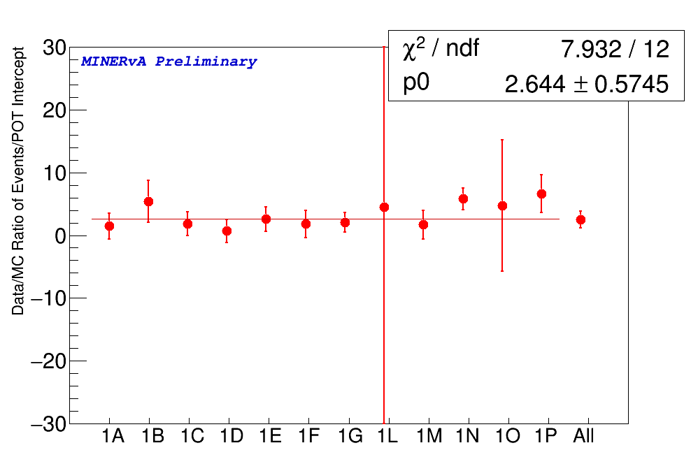
Playlist by Playlist Comparison
Intro
Details
Checks
Intensity Dependence Reco. Uncrt. Study
Event Scan
Summary
Current Status
Different playlist shows consistency as well

Slide 20
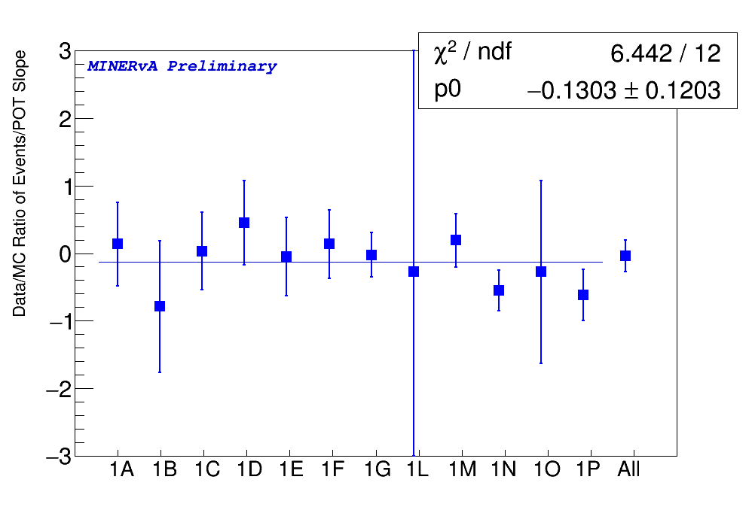
Playlist by Playlist Comparison
Intro
Details
Checks
Intensity Dependence Reco. Uncrt. Study
Event Scan
Summary
Current Status
Different playlist shows consistency as well
More details:
DoC-DB 21242

Slide 21
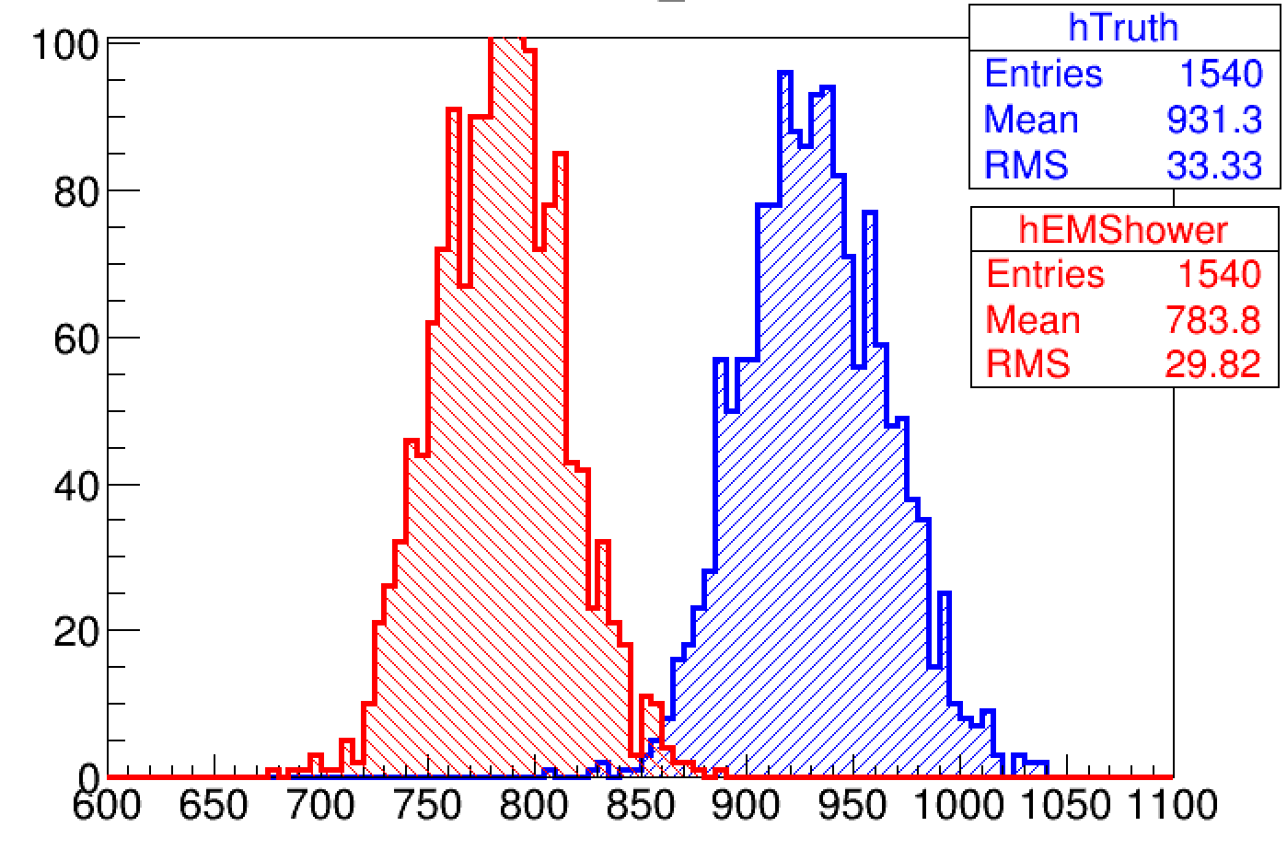
Reconstruction Failure
Intro
Details
Checks
Intensity Dependence Reco. Uncrt. Study
Event Scan
Summary
Current Status
NuE Signal only data overlaid MC sample from all playlist
Entries from Meta tree before and after reconstruction
Analysis Packages
/Ana/AntiNuE/macros/signal/RecoFailure.C
/Ana/AntiNuE/macros/create_arachne_links/reco_arachne_link_creator

Slide 22
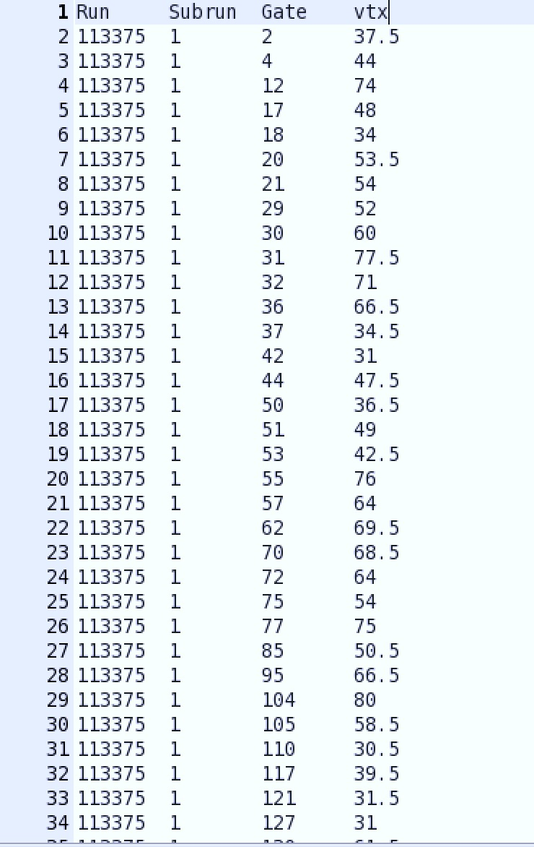
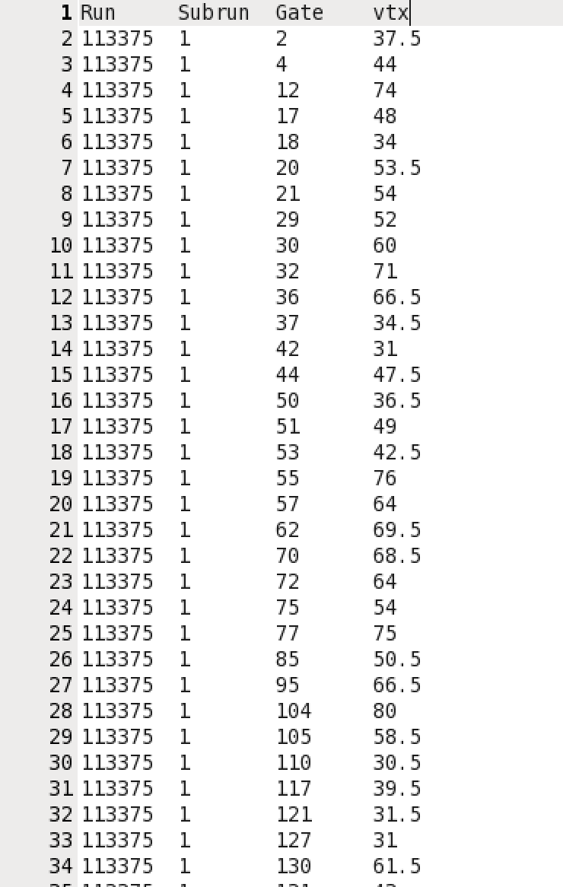
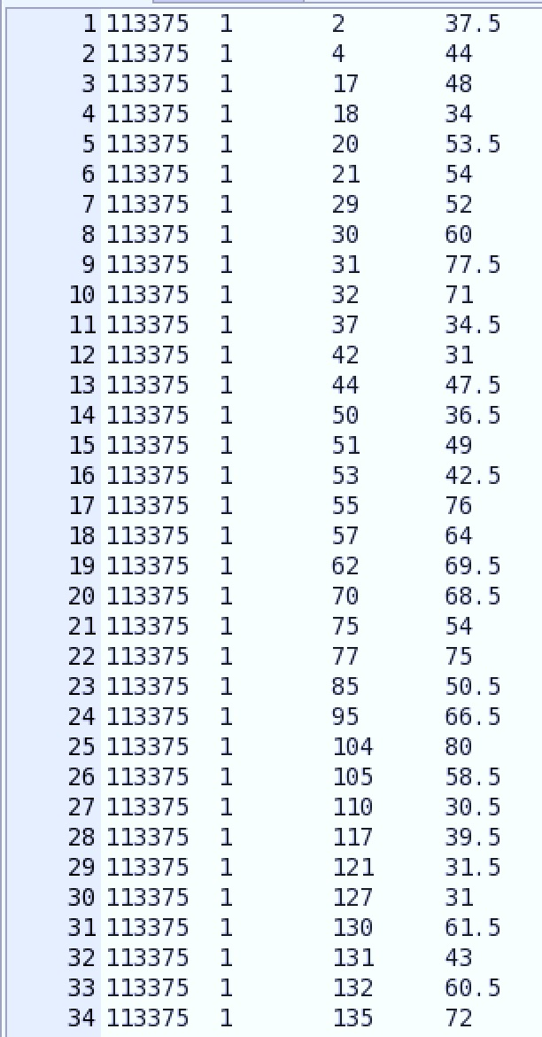
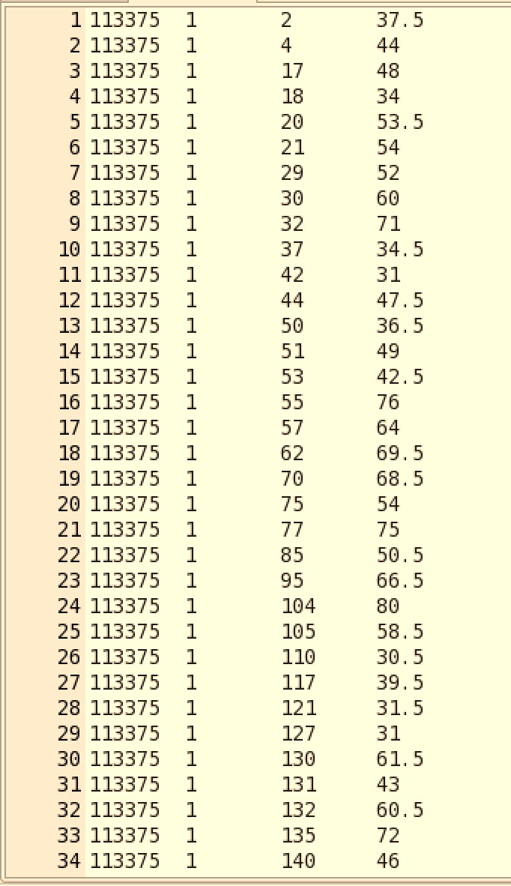
List of Events Failed Reconstruction
Intro
Details
Checks
Intensity Dependence Reco. Uncrt. Study
Event Scan
Summary
Current Status
Before reconstruction
from Truth tree
After reconstruction
from EMShower tree
Used MC signal only sample Aug 2018
Applied fiducial cut and energy>500 MeV (default is 800)
No other cuts applied
Created a list of all the failed events
Failed EMShower reconstruction for the entire ME is 1.83% (7185 events)
Total events: 393245
Total events: 386060

Slide 23
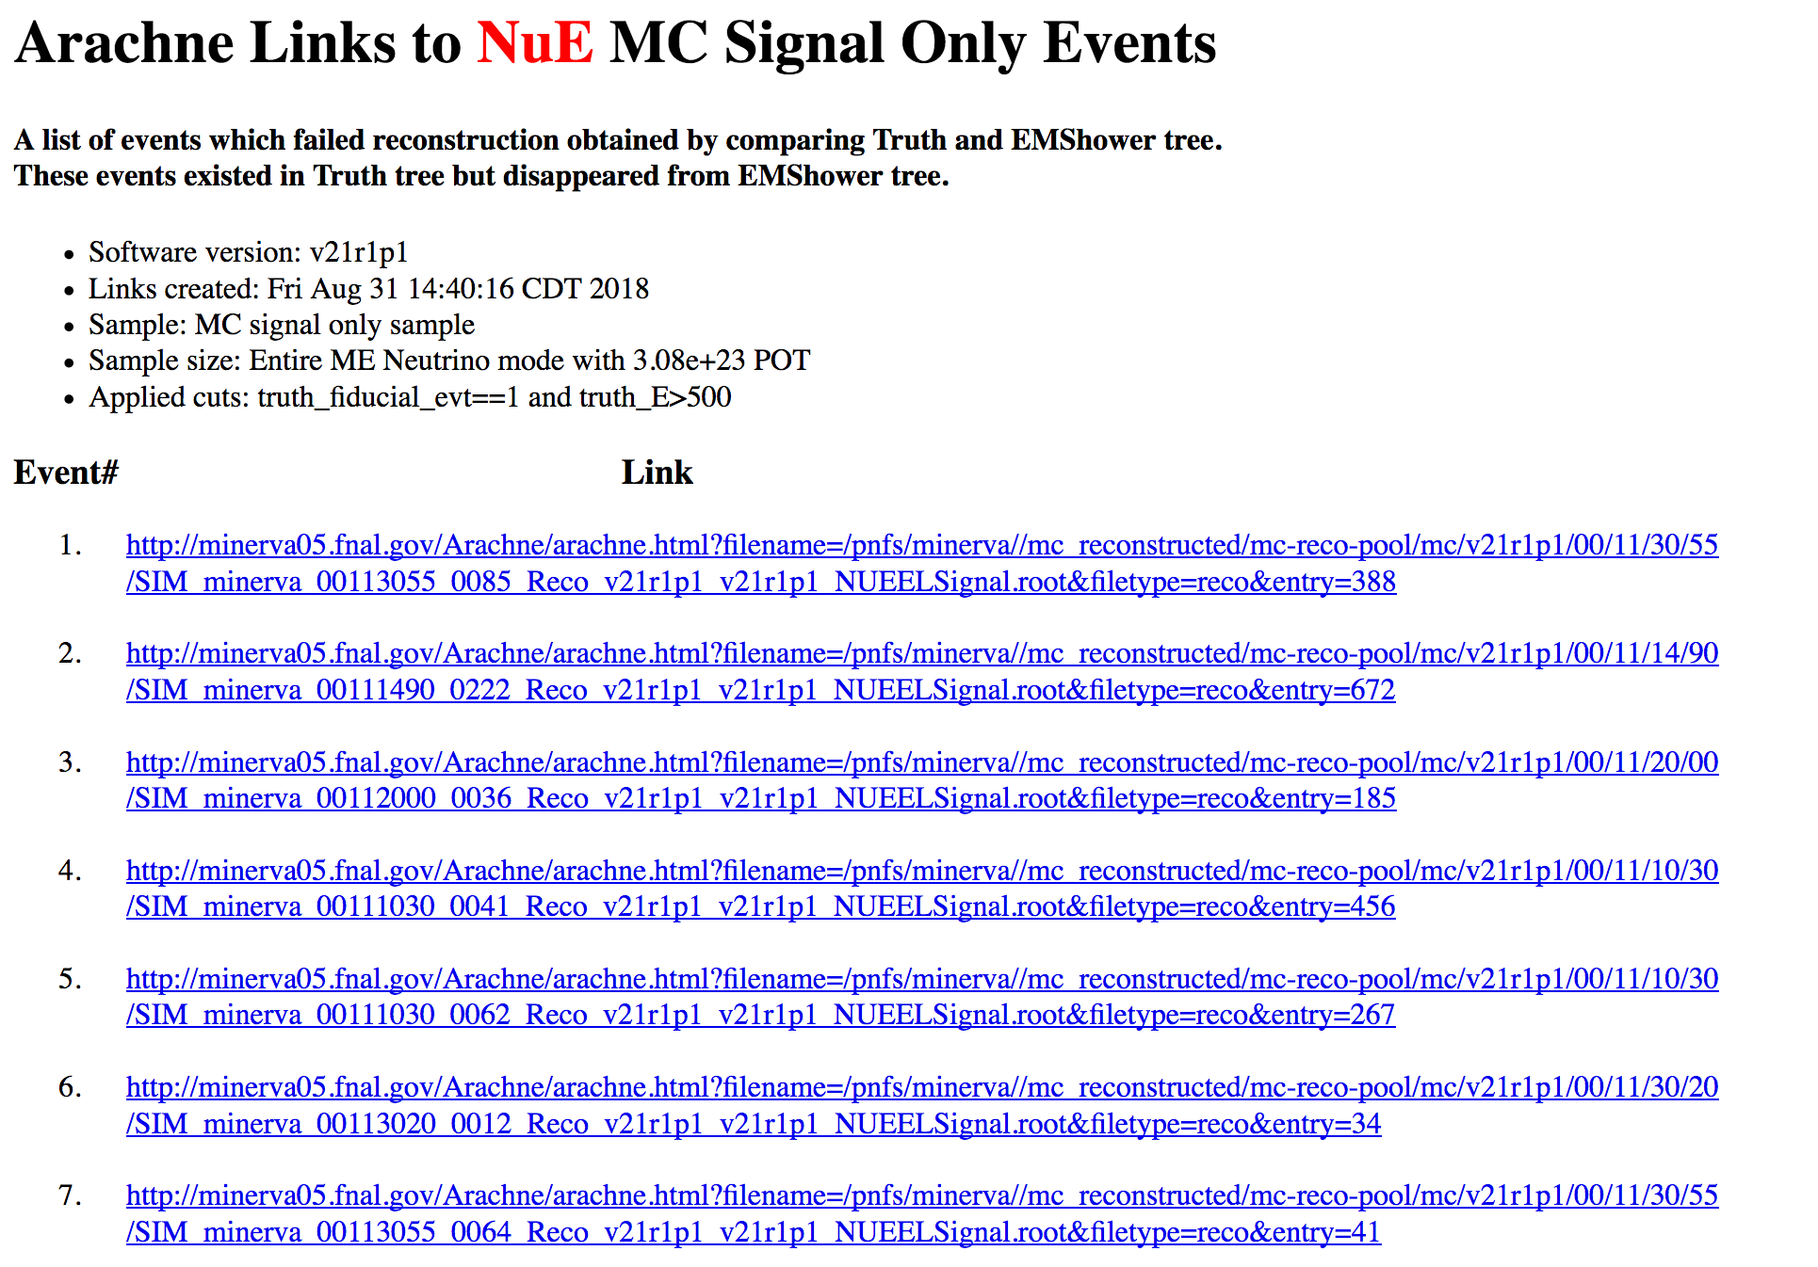
Failed Events
Intro
Details
Checks
Intensity Dependence Reco. Uncrt. Study
Event Scan
Summary
Current Status
A list of all the events that failed reconstruction:
https://cdcvs.fnal.gov/redmine/projects/minerva/wiki/Failed_reconstruction_events_for_ME_NuE_MC_signal_only_sample#section-2
Preliminary Result
Total scanned events: 100
Categorized in orphan events: 55%
Events with deadtime: 39%
Don’t know why it failed: 5%
No EMShower: 1%
More details:
DoC-DB 20400
Scanned these event to evaluate what’s going on.

Slide 24
Failed Events
Intro
Details
Checks
Intensity Dependence Reco. Uncrt. Study
Event Scan
Summary
Current Status
A list of all the events that failed reconstruction:
https://cdcvs.fnal.gov/redmine/projects/minerva/wiki/Failed_reconstruction_events_for_ME_NuE_MC_signal_only_sample#section-2
One Example:
MC:
http://minerva05.fnal.gov/Arachne/arachne.html?filename=/pnfs/minerva//mc_reconstructed/mc-reco-pool/mc/v21r1p1/00/11/30/55/SIM_minerva_00113055_0188_Reco_v21r1p1_v21r1p1_NUEELSignal.root&filetype=reco&entry=883
Data:
http://minerva05.fnal.gov/Arachne/arachne.html?det=MV&recoVer=v21r1p1&run=19452&subrun=21&gate=152&slice=-1
Scanned these event to evaluate what’s going on.

Slide 25
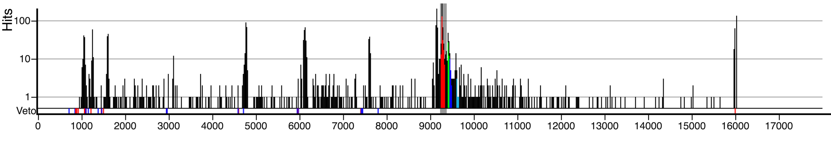



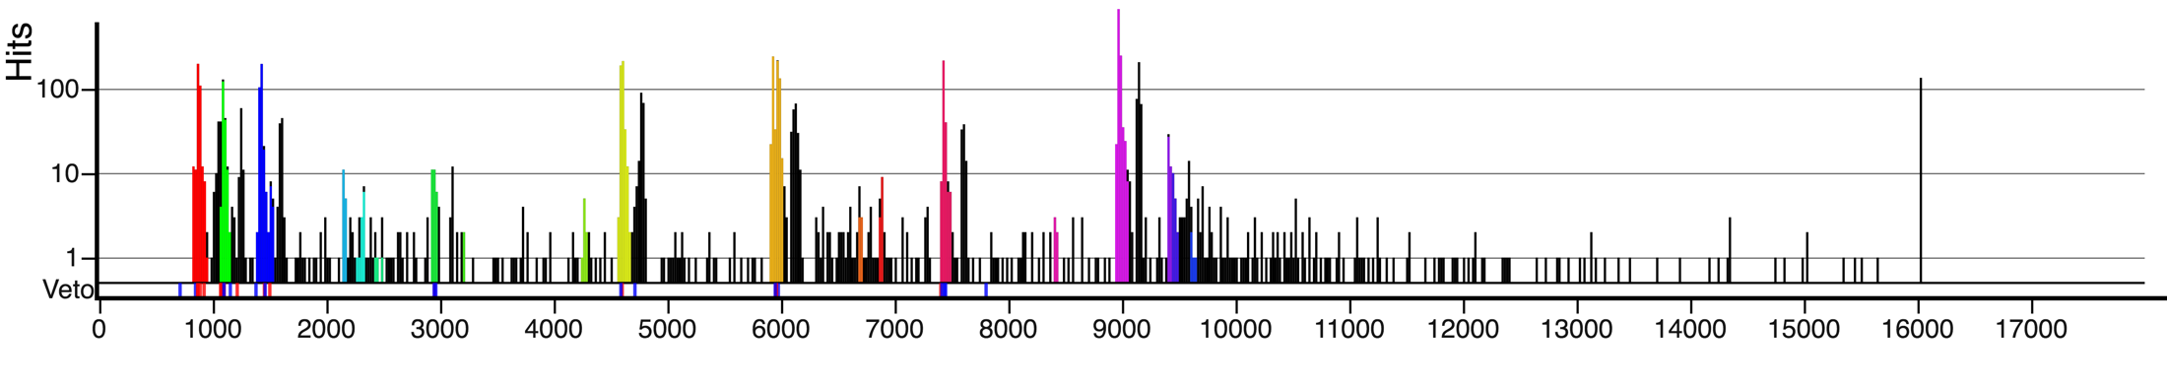
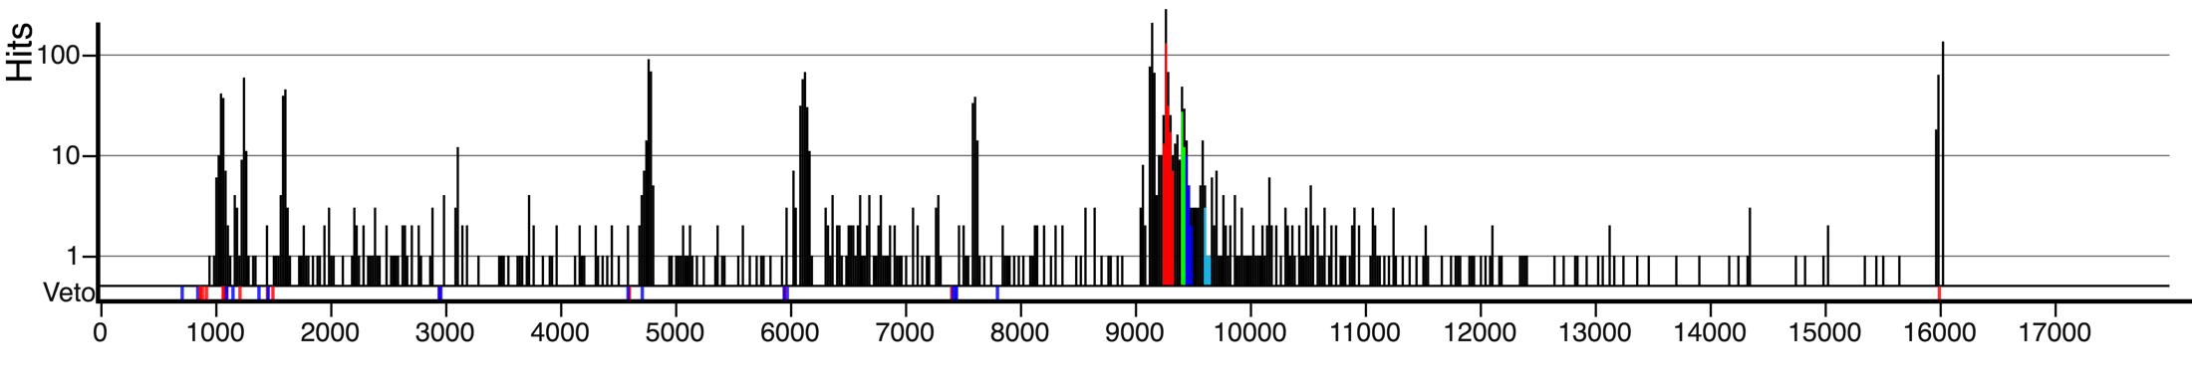
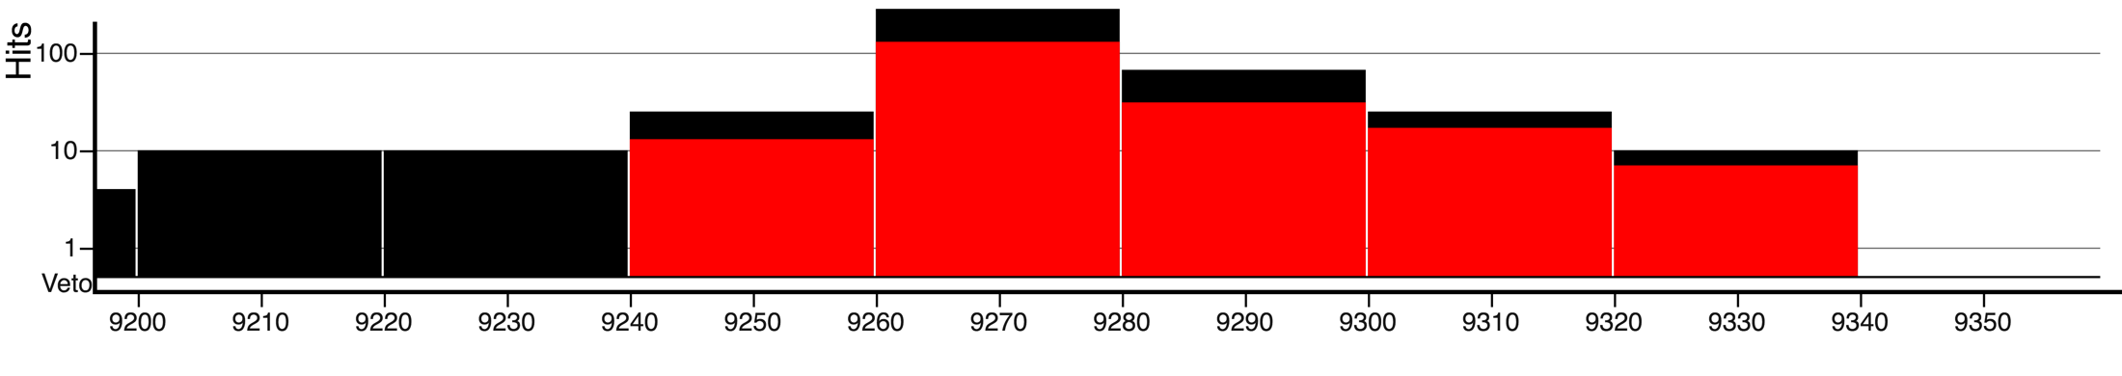
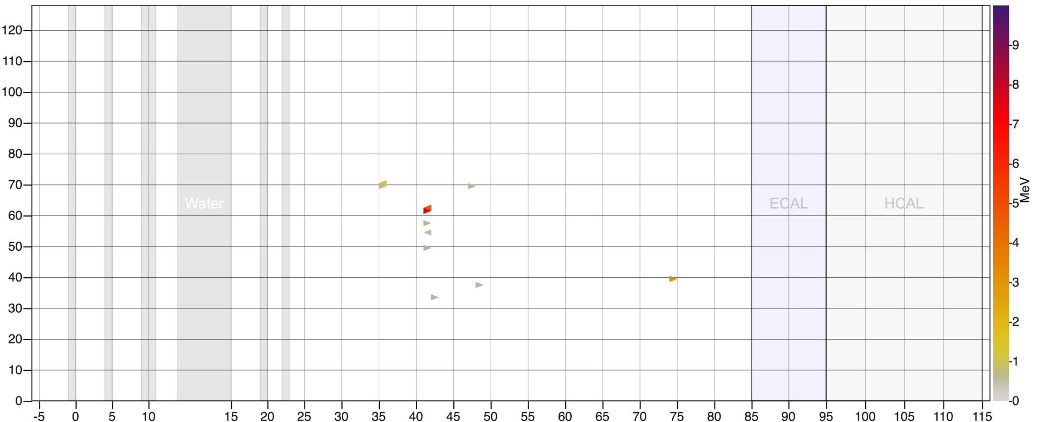
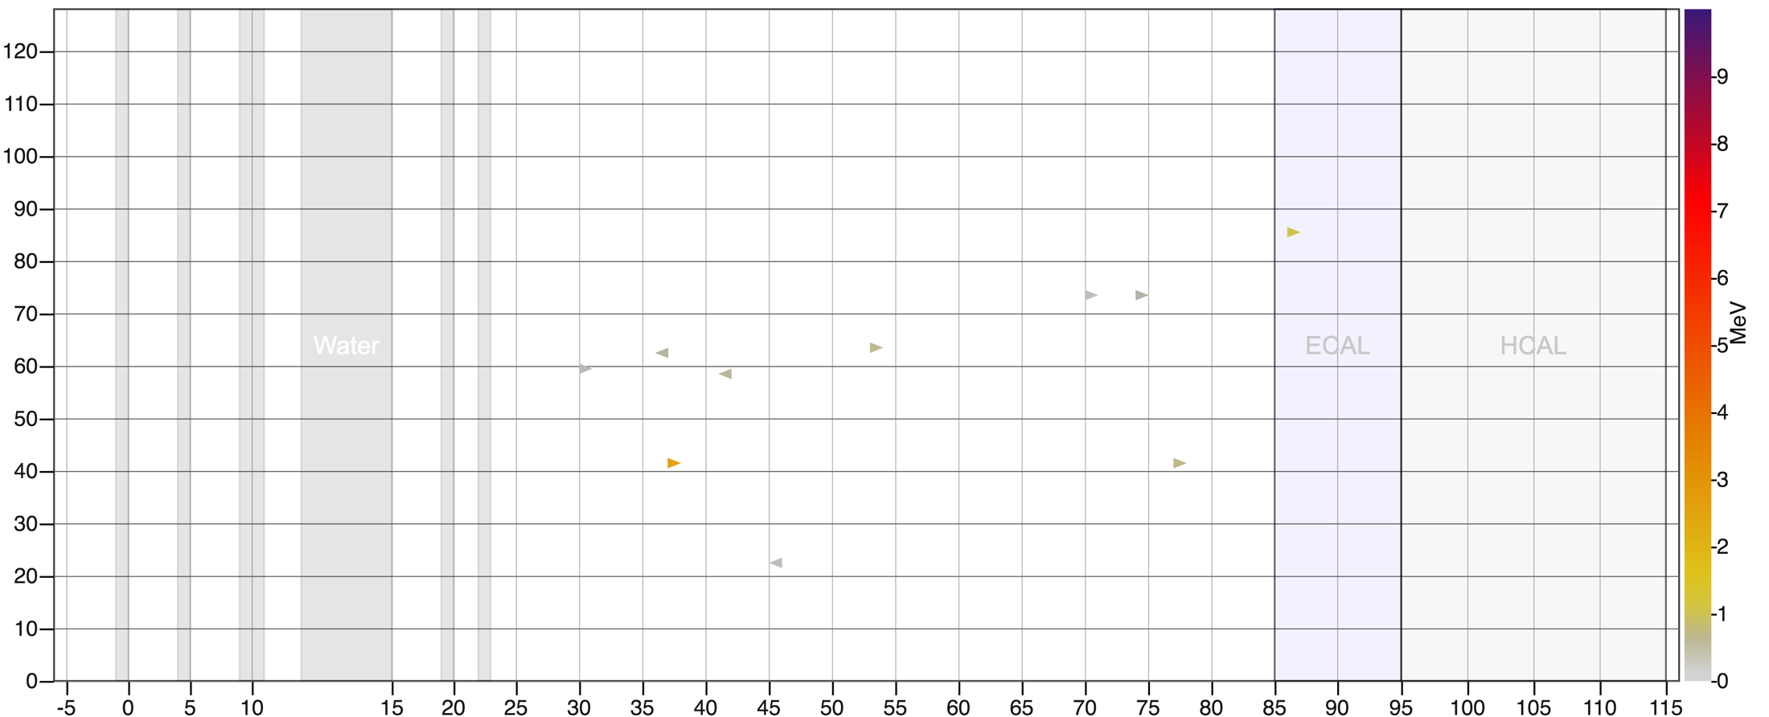

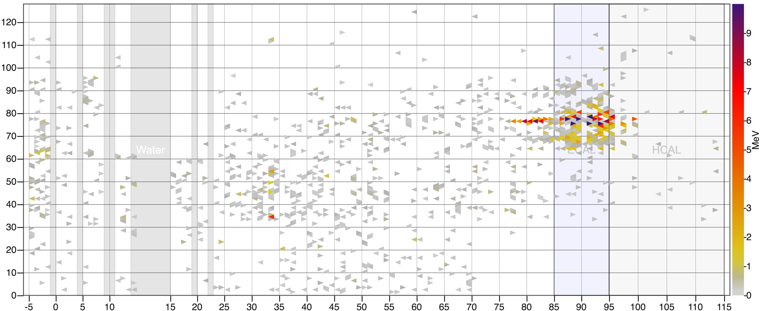

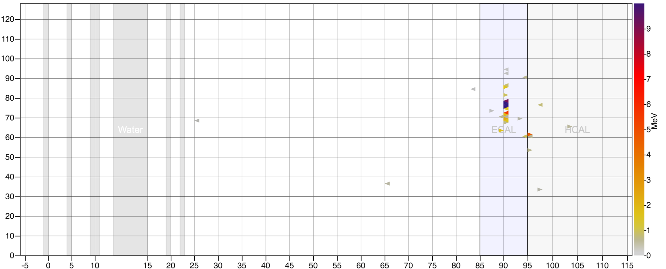
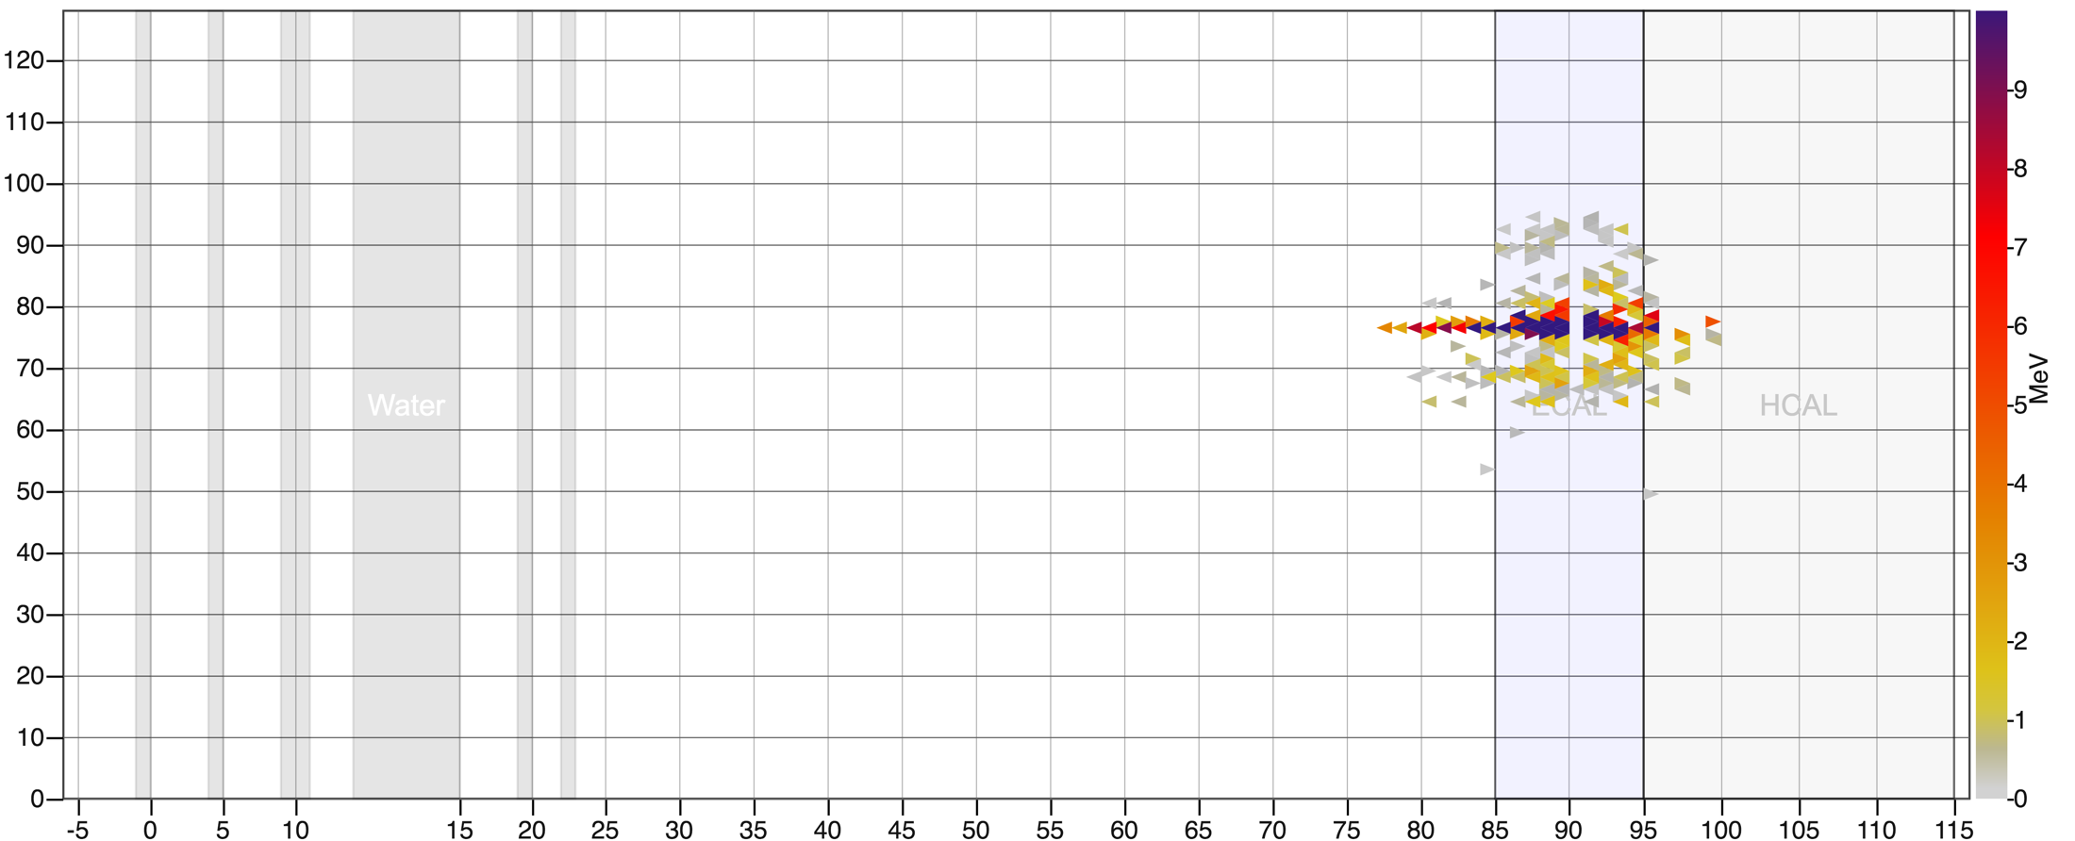
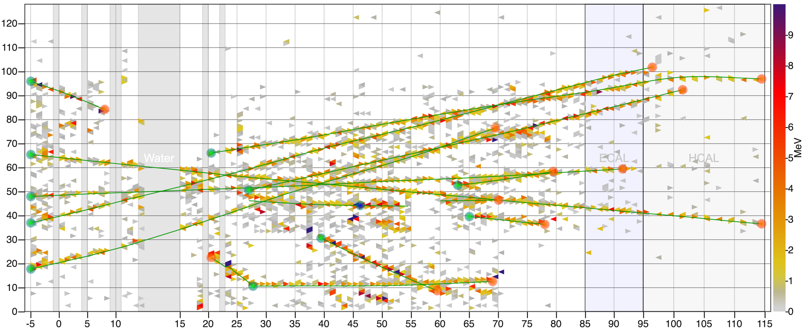
Event Display
Intro
Details
Checks
Intensity Dependence Reco. Uncrt. Study
Event Scan
Summary
Current Status
slice:All Hits
slice:Slice 1
slice:Slice 2
slice:Slice 3
slice:Slice 4
slice:All Hits
slice:All Hits
slice:Orphan Hits
slice:Orphan Hits
Data
MC
MC + Data
Event
Time [ns]
Time [ns]
Time [ns]
Time [ns]
Time [ns]
Time [ns]
Time [ns]
Time [ns]
Time [ns]
1 2 3 Water 4 5 Active Tracker ECAL HCAL
1 2 3 Water 4 5 Active Tracker ECAL HCAL
1 2 3 Water 4 5 Active Tracker ECAL HCAL
1 2 3 Water 4 5 Active Tracker ECAL HCAL
1 2 3 Water 4 5 Active Tracker ECAL HCAL
1 2 3 Water 4 5 Active Tracker ECAL HCAL
1 2 3 Water 4 5 Active Tracker ECAL HCAL
1 2 3 Water 4 5 Active Tracker ECAL HCAL
1 2 3 Water 4 5 Active Tracker ECAL HCAL
Energy deposition scale
Energy deposition scale
Energy deposition scale
Energy deposition scale
Energy deposition scale
Energy deposition scale
Energy deposition scale
Energy deposition scale
Energy deposition scale
Module number
Module number
Module number
Module number
Module number
Module number
Module number
Module number
Module number

Slide 26
Summary
Intro
Details
Checks
Intensity Dependence Reco. Uncrt. Study
Event Scan
Summary
Current Status
Beam angle and other vertex variables look reasonable
From NuE MC Signal Only sample we don’t see any intensity dependence for efficiency
MC model our data quite well and don’t see intensity dependence
Most of the reconstruction failures are coming from deadtime due to pileup

Slide 27
Summary of Scanned Events
Intro
Details
Checks
Intensity Dependence Reco. Uncrt. Study
Event Scan
Summary
Current Status
Total scanned events: 100
Preliminary Result
Categorized in orphan events: 55%
Events with deadtime: 39%
Don’t know why it failed: 5%
No EMShower: 1%
Final observation
Deadtime due to pileup: 82%
Failed: 18%
Reconstruction Efficiency Uncertainty for NuE = ~1.83x0.18% = ~0.33%
As the Reconstruction efficiency uncertainty is negligible, we are not going to list it in our systematic uncertainty table for NuE analysis.
Google DoC with scanned links and comments:
https://docs.google.com/spreadsheets/d/19H4g3tFXGEBinGOjbzKobkBrMBfilwg9JAJFLDuRjgQ/edit#gid=0

Slide 28
Result from Muon Analysis
Intro
Details
Checks
Intensity Dependence Reco. Uncrt. Study
Event Scan
Summary
Current Status
https://minerva-docdb.fnal.gov/cgi-bin/private/ShowDocument?docid=18777 - Xianguo Lu
Estimated Reconstruction Efficiency Uncertainty ~0.3%
Method:
The reconstruction efficiency uncertainty for muons is determined by comparing the data and MC for the efficiency of matching a muon track in the MINERA detector with a MINOS matched track. The discrepancy between data and simulation is treated as the systematic uncertainty.

Slide 29
NuE Analysis Status Update
Intro
Details
Checks
Intensity Dependence Reco. Uncrt. Study
Event Scan
Summary
Current Status
Uncertainties after tuning SB1 → SB3
With Wiggle
Without Wiggle
Using FluxReweighter
Using FluxReweighterWithWiggleFit
More Details
1000 universes
All me1 playlists
Nu-e constraint is not applied
Radiative Corrections
DFR-NC Added, but not scaled
ECal correction applied everywhere
Courtesy: Edgar

Slide 30
NuE Analysis Status Update
Intro
Details
Checks
Intensity Dependence Reco. Uncrt. Study
Event Scan
Summary
Current Status
The increase in Genie uncertainty don’t appear when the wiggle effect was used but uncertainties increase when wiggle effect was removed for these cases:
CV + Radiative Correction
CV without Rad Corr.
The issue disappear when any of the 8 MC channels turned off or when we apply the CCQEBkg wgt.
Results from last September didn’t show this issue.
There might be a bug introduced in recent times. Will be seeking help from Dan and Trung to fix the issue.
Courtesy: Edgar

Slide 31
Flux Constraint Status Update
Intro
Details
Checks
Intensity Dependence Reco. Uncrt. Study
Event Scan
Summary
Current Status
More details:
DoC-DB 21200
Courtesy: Deepika
Fractional uncertainty (RMS/mean) from the probability distribution of integral of flux universes from 2 - 20 GeV (from left fig.) ~11.5% for unconstrained and ~7.8% for constrained
The fractional flux uncertainty between 2 – 20 GeV from right fig. is within 8% - 12% for unconstrained and within 7 – 9 % for constrained flux.
Aim is to get consistency between these two figs.

Slide 32
Thank You

Slide 33
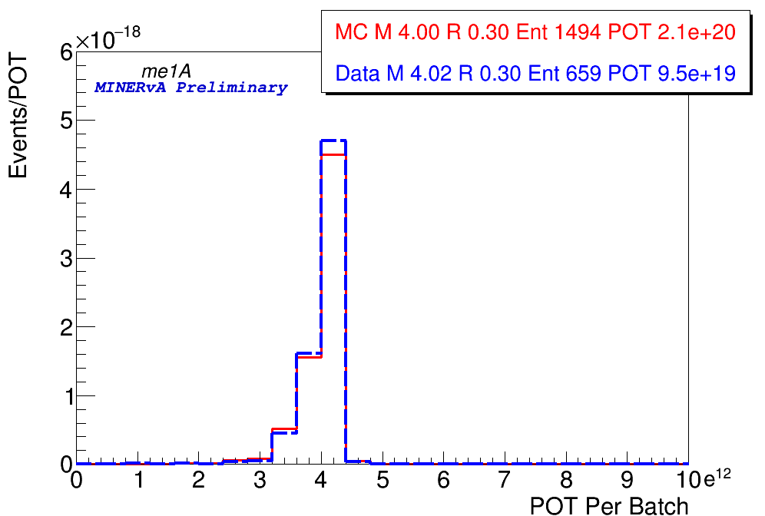
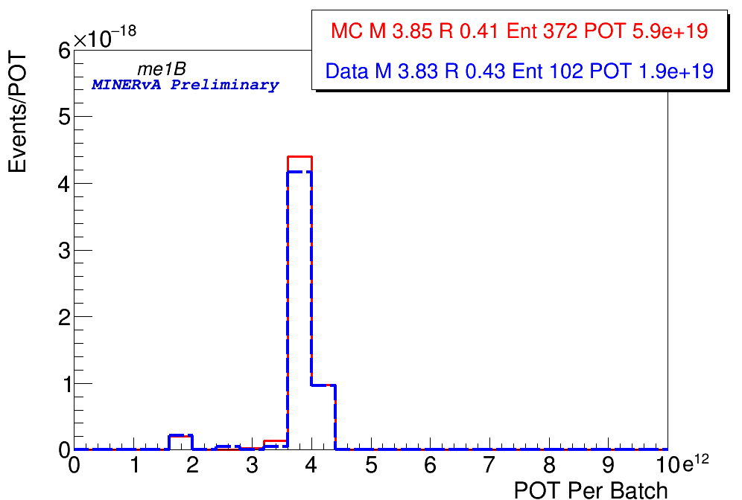
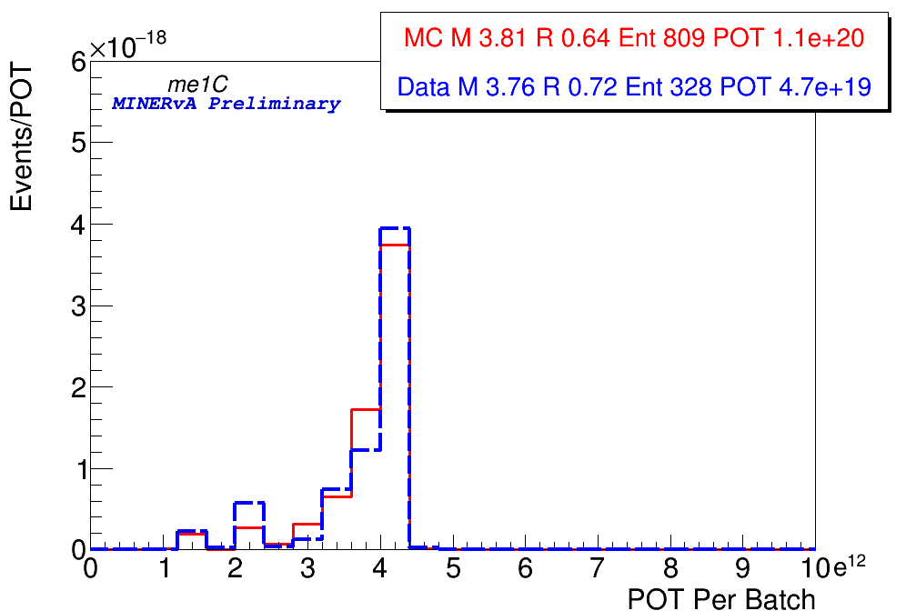
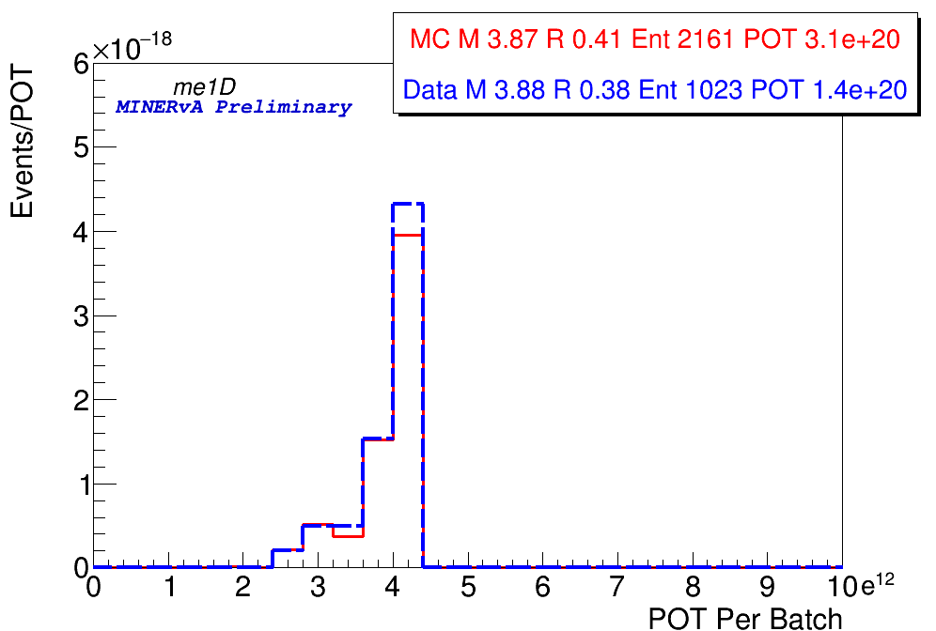
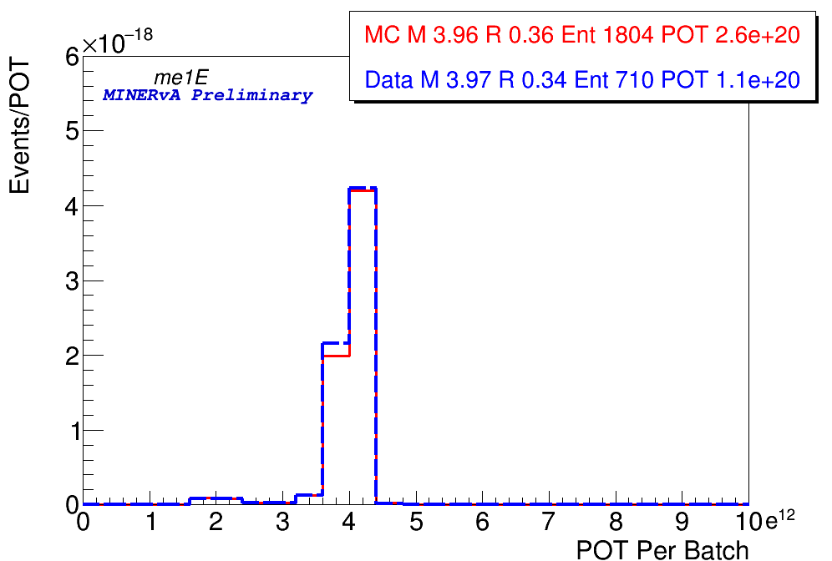
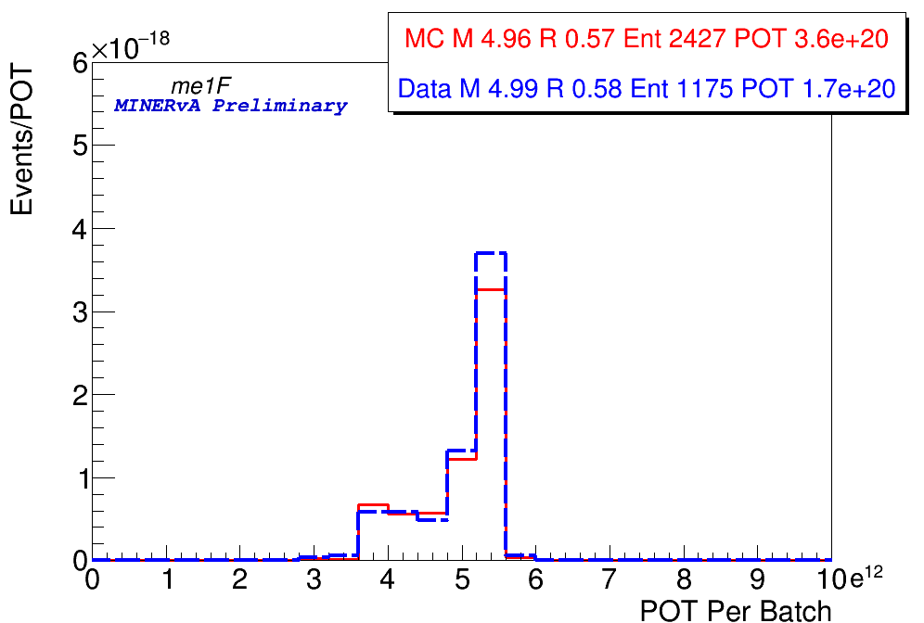
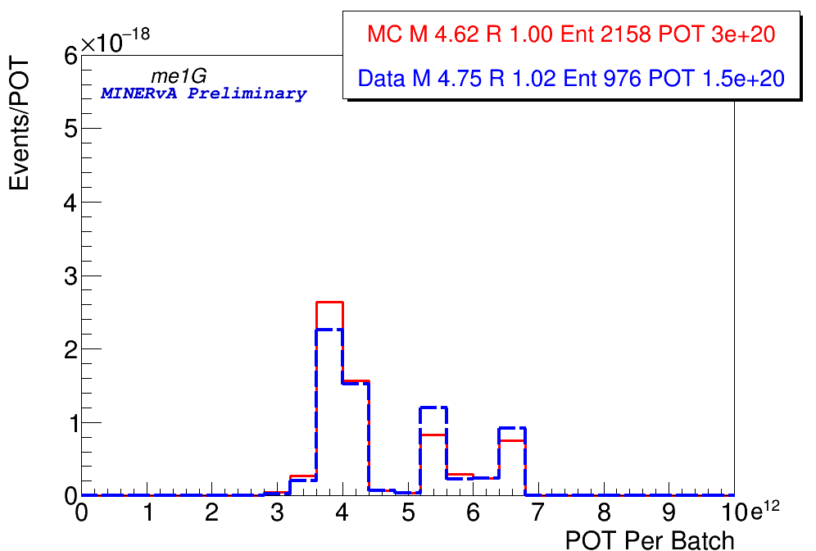
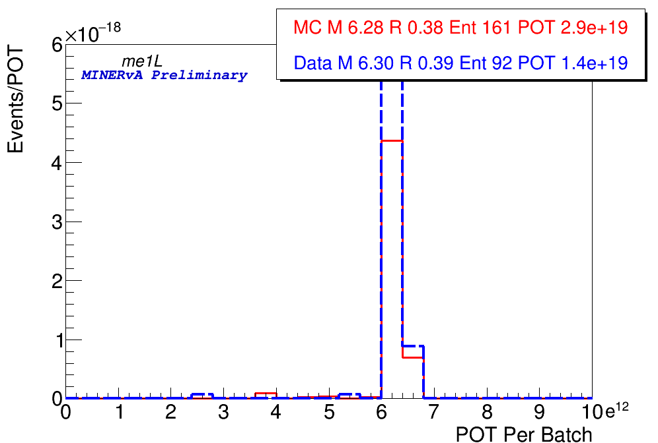




All Playlist

Slide 34












All Playlist Ratio

Slide 35
Processing Issues
Identified issues with Data playlist me1D.
The files seems to be corrupted, the anatuple variables are not filled properly, but the Meta tree is populated so the POT counting is working. Only POT_Used is filled but other variables are not. This may create issues as we are not including these files in our analysis, but including the POT.
Removed first 12 files from playlist me1D: 10255/1-12.
Missing POT 4.06x10¹² for 10255/1-12. A small number of files and we should be ok as long as scripts don’t fail to run for the playlist.

